Slide 1

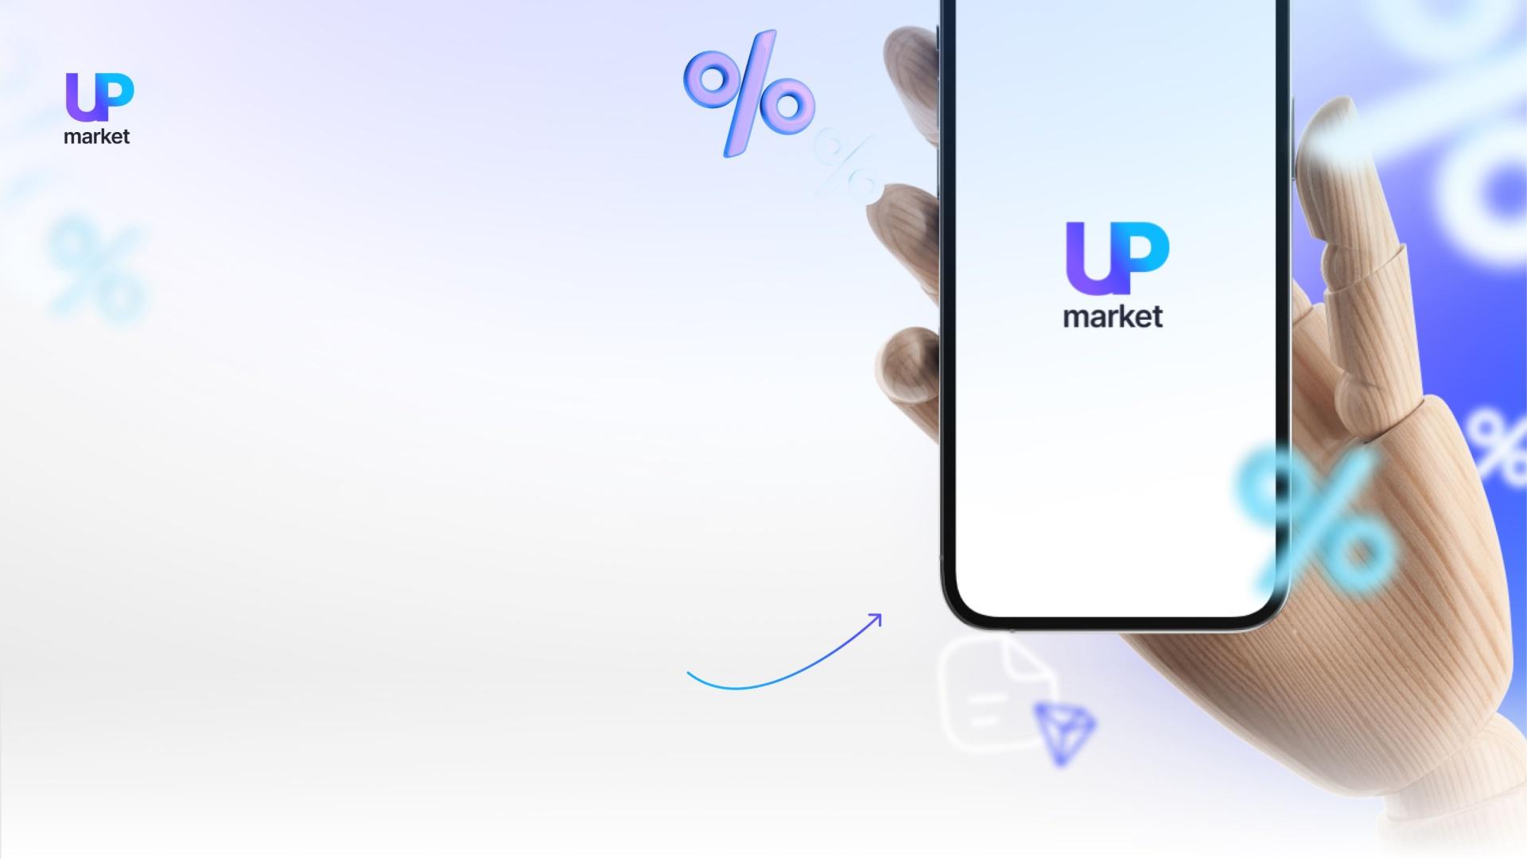
The
«Мarket-Up»
platform
Decentralized marketplace built on blockchain technology.

Slide 2
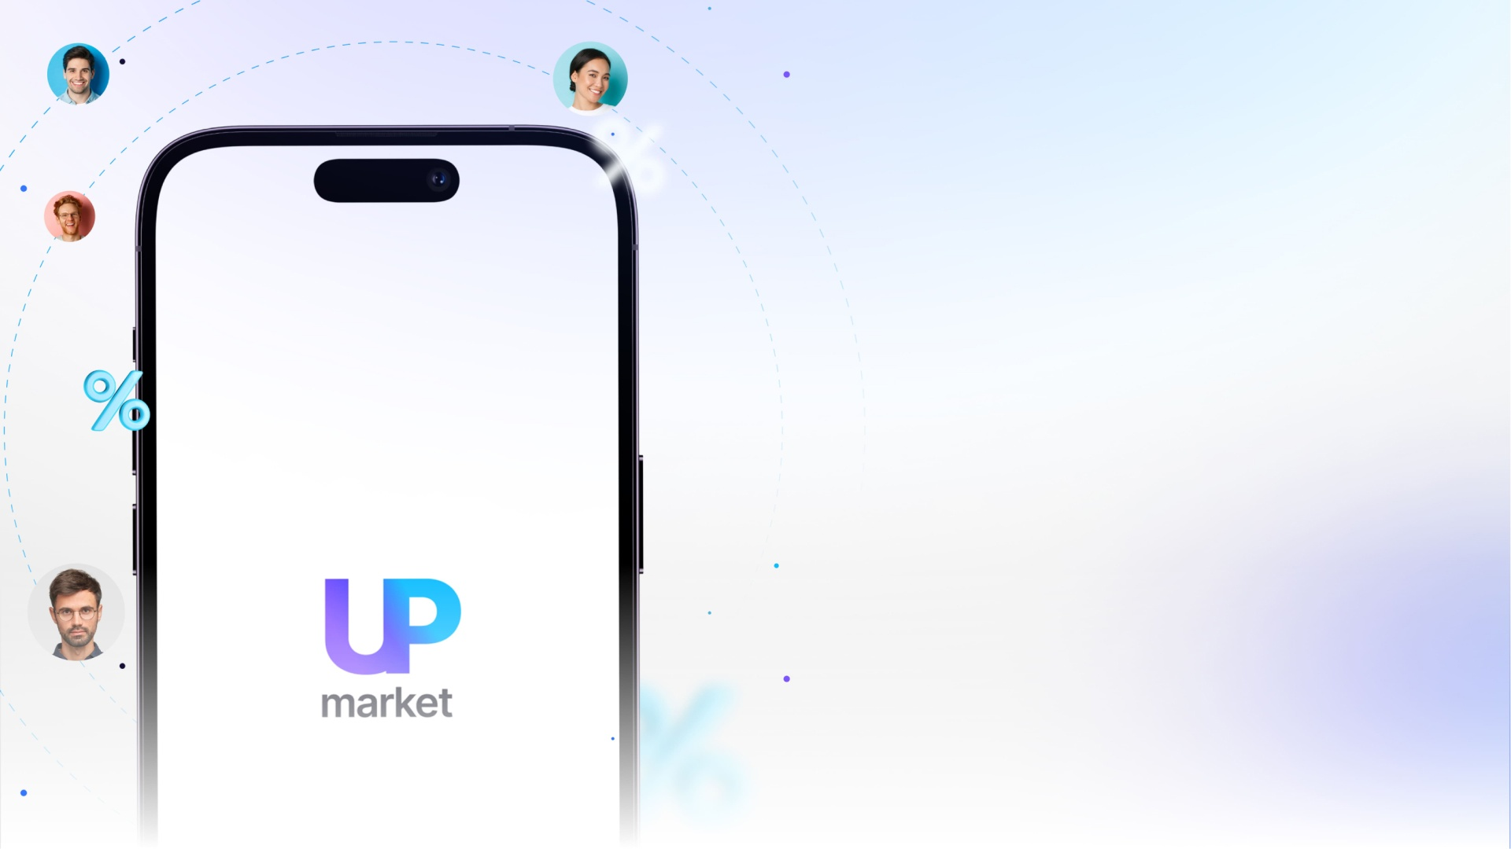


Market-Up
market
Advanced blockchain technologies and smart contracts are used in the latest development.
The decentralized marketplace.
Create and sell vouchers to your products and services at a discount, as well as sell and
buy vouchers from other program participants.
«MARKET-UP» Marketing Program.
A personal blog.

Slide 3

«Мarket-Up»
- what is it?
In «MARKET-UP» smart-contracts are used to implement advanced blockchain technologies.
Vouchers downloaded from the blockchain network are fixed in the network, enabling you to determine their individuality.
By digitizing hosted files, the platform provides users with protection.

Slide 4
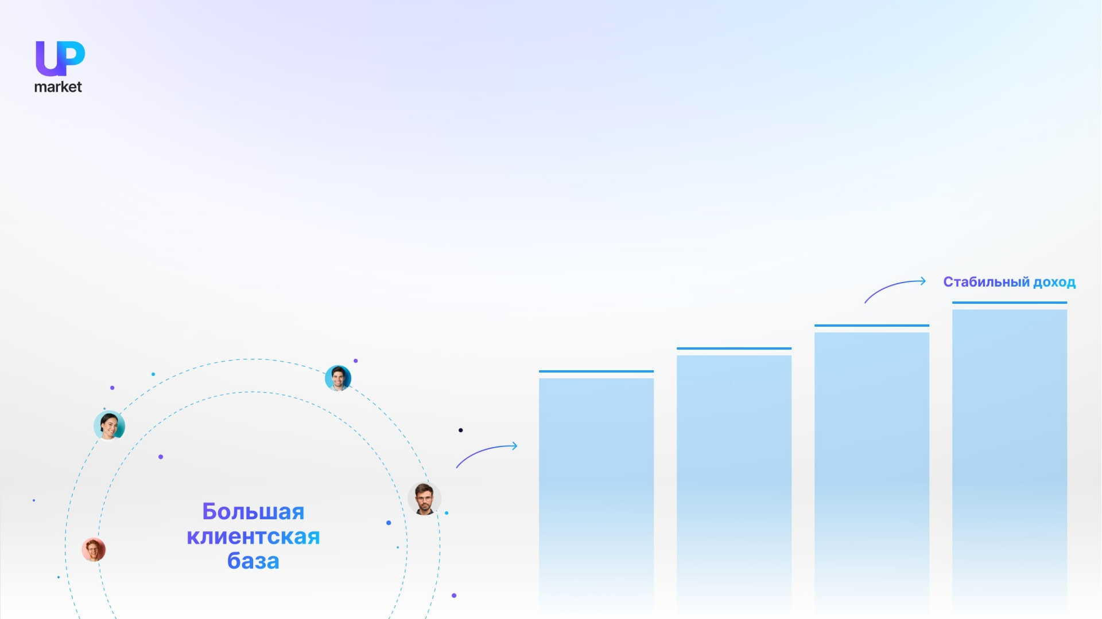
Advertising and marketing programs are designed to attract users to generate long-term and stable income for everyone involved.
Marketing of «Мarket-Up»
By selling and advertising memberships through the marketing program, members are able to build a large customer base.

Slide 5
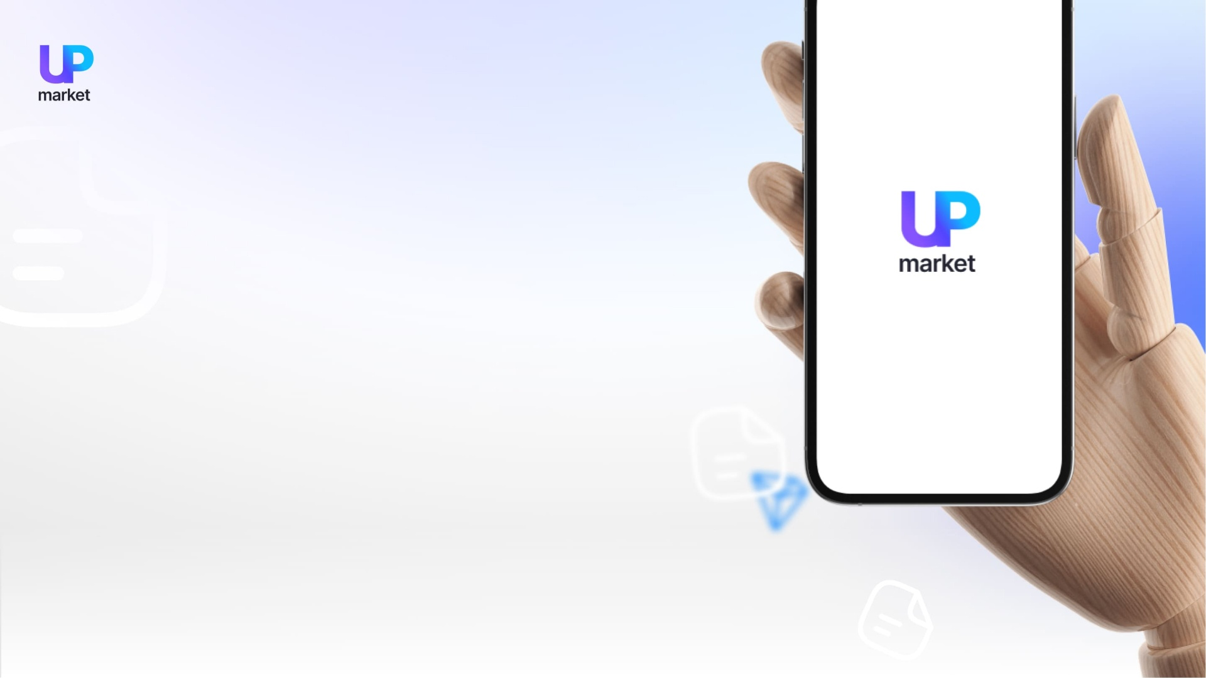
«Мarket Up»
smart-contract
Using the TRX cryptocurrency, the «Market-Up» marketing program is built on the TRON smart contract
A decentralized program is based on an automated contract that ensures maximum security, stability, and transparency.
Smart contracts are algorithms that execute tasks automatically.
On the TRON blockchain, the logic of the smart contract is recorded. In this way, the smart contract is protected from modification, hacking, and stopping.

Slide 6
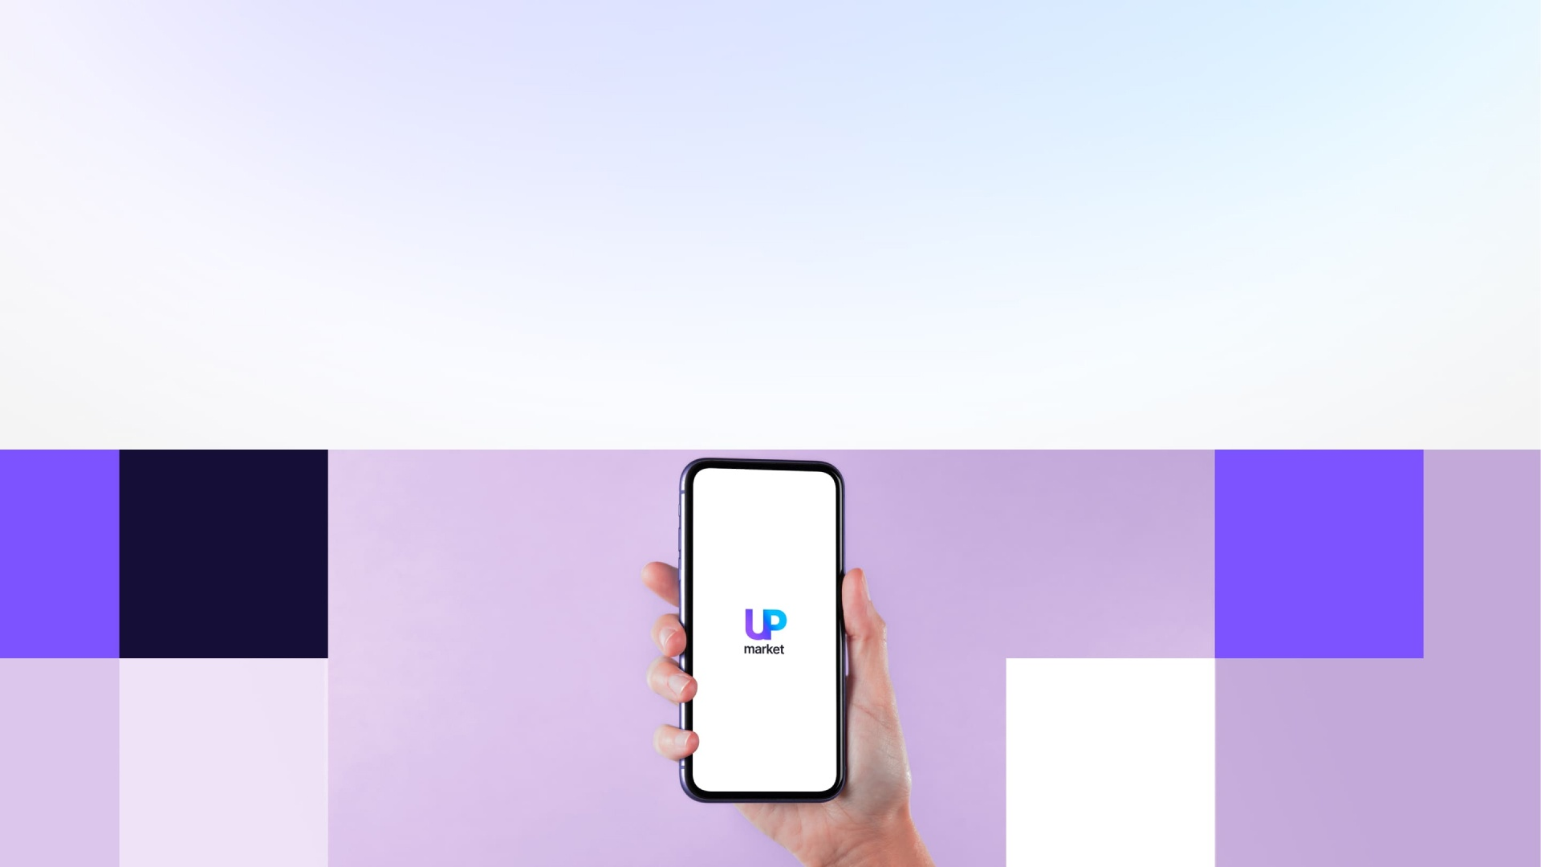
Voucher
creation and sales
Users of the «MARKET-UP» platform can voucher by completing a simple registration process.
Vouchers from other participants in the program can also be sold.

Slide 7
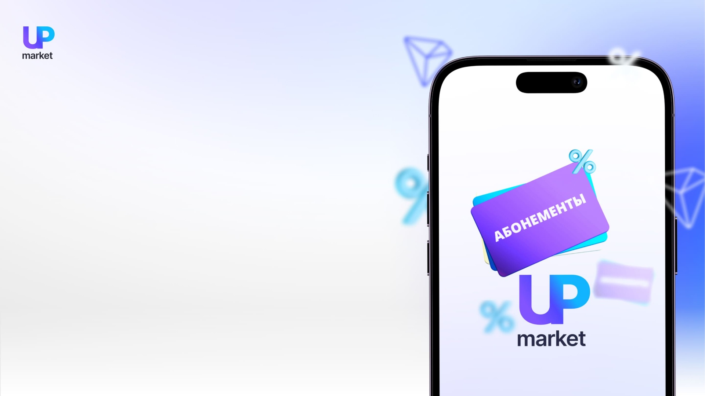
Voucher
payments
On the Platform, all transactions are conducted directly between seller and buyer. In the cryptocurrency TRON (TRX), payment for the purchased works is instantly transferred to the personal wallet of the P2P seller.
Earned funds are not expected or concluded.

Slide 8
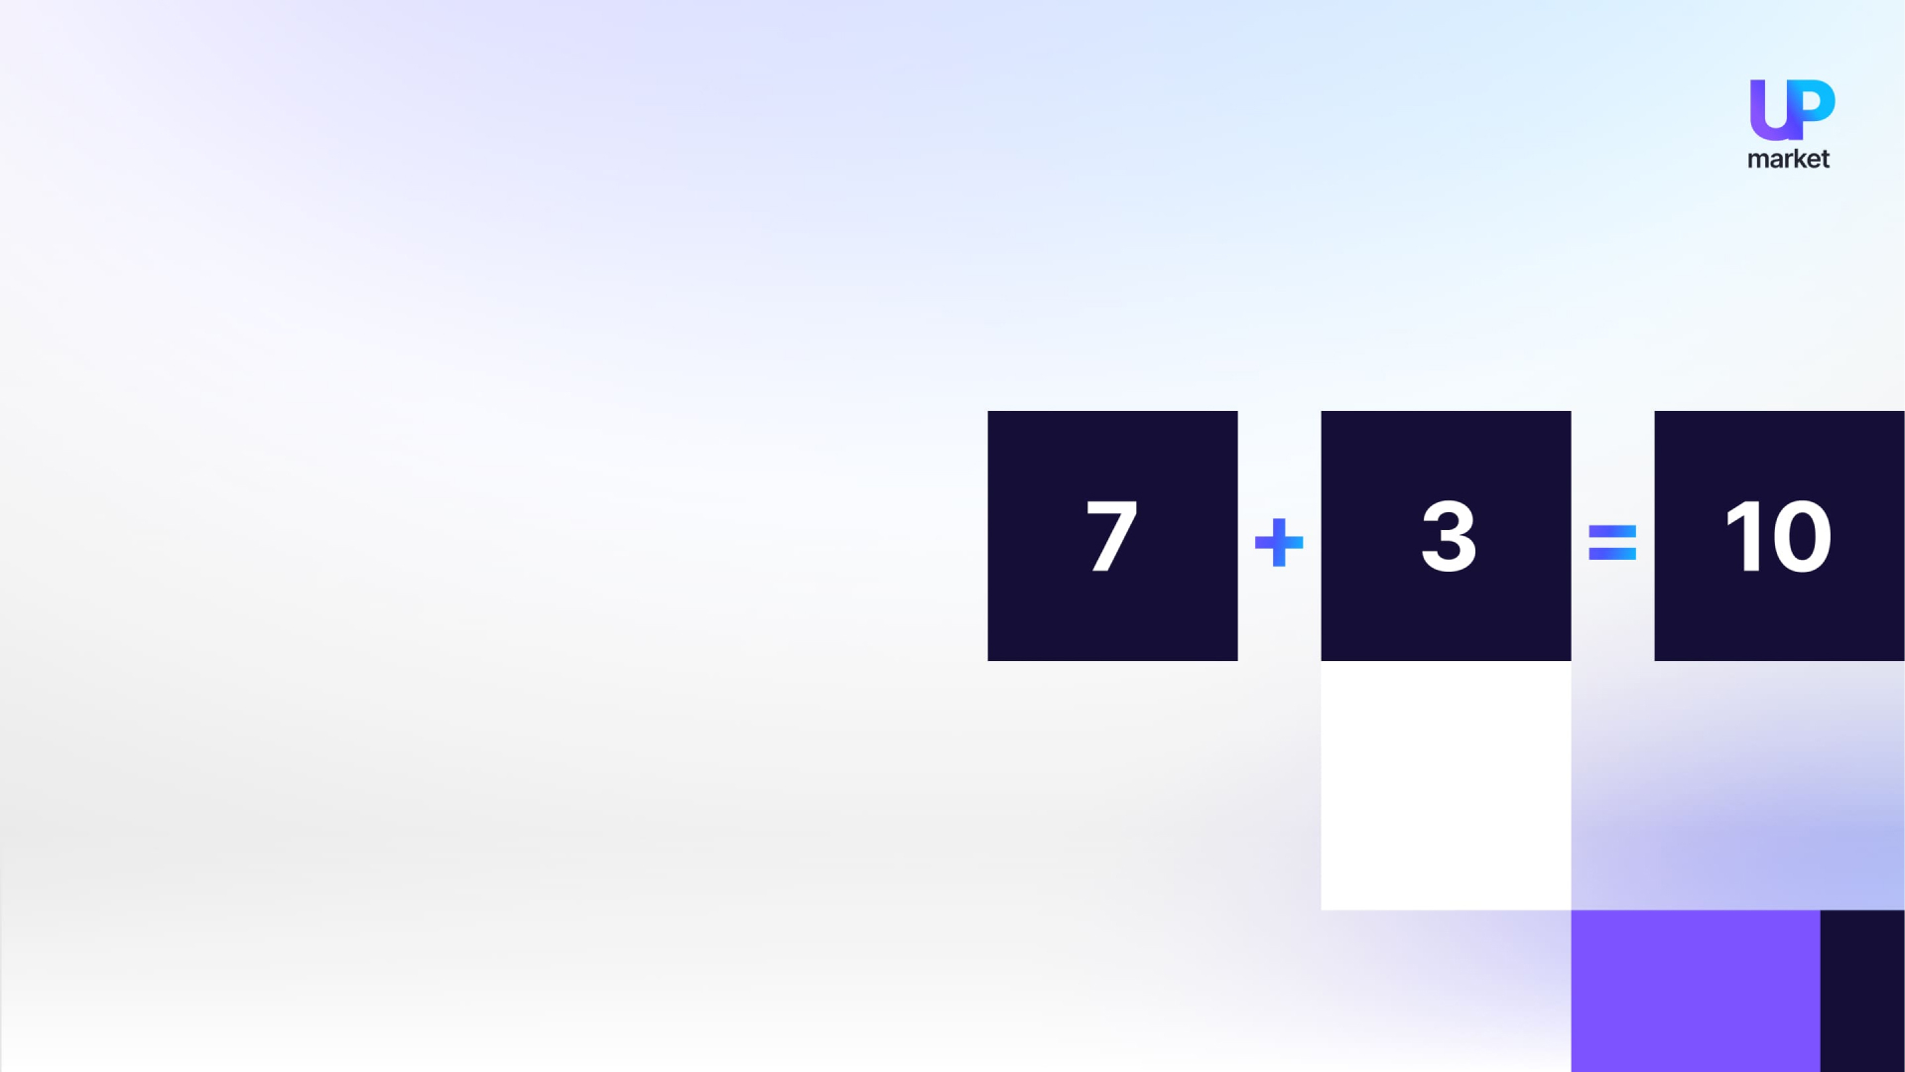
Activation of the account
You must activate your «MARKET-UP» account to take part in the marketing program.
You can purchase 10 vouchers from 7 higher-level program participants whose accounts have been activated, and 3 from any "active" program participants you choose (you can also purchase vouchers from lower-level program participants).

Slide 9
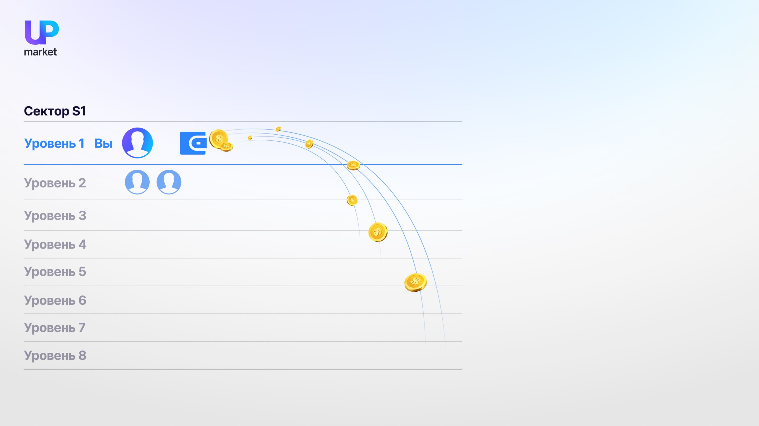
The S1 sector
Participants of the marketing program are placed on the first level of the main sector S1 when the program is activated.
Upon inviting new users to the platform, they are placed on the second level of the main sector S1 and are your direct referrals.
These invitees will be located at the third level of your sector, making them third-level referrals for you.

Slide 10
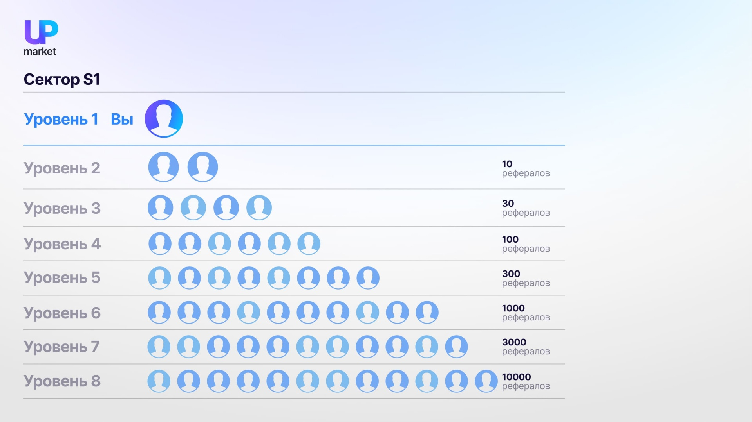
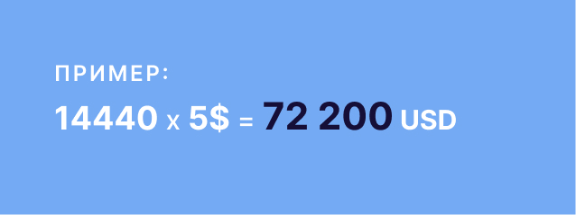
S1 sector income
Every active participant can quickly build a customer base for their subscriptions by participating in the marketing plan
«MARKET-UP».
The members of your team who will bring you a monthly income are located in the main sector S1.
The downstream partners are located at levels corresponding to the invitation order in Main Sector S1.
The program's active members buy vouchers from you up to the eighth level.
Upon sale of a voucher, your wallet will be credited with 5 USDT.
You and your team are the only ones responsible for your income on the «MARKET-UP» platform.

Slide 11
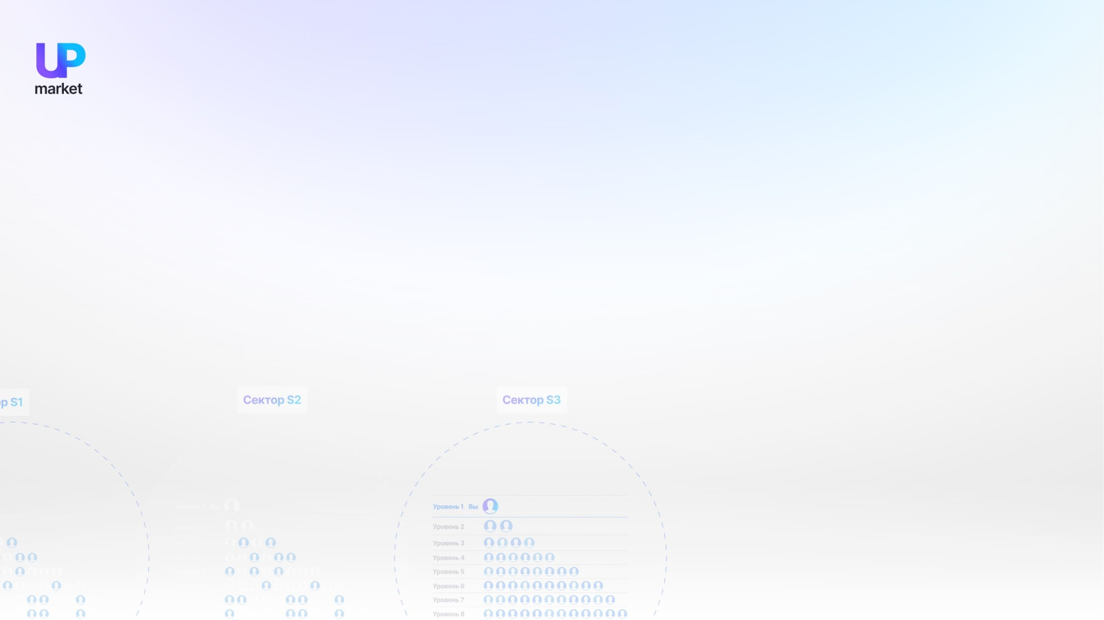



Activation of the account
The initial activation is as follows:
Account activation is not required for one month when inviting one direct participant to the program. Invitations are cumulative.
Buy 10 vouchers for 6 USD each
The activation of accounts occurs on a monthly basis.
In order to do this, you will need:
An example would be that if the account has 5 direct invitees, you do not need to confirm the activity of the account for 5 months.
A voucher activation is as follows:
The gallery must have the required number of vouchers.
The vouchers of inactive users on the marketplace are temporarily unavailable for sale until their accounts are activated again. Downstream users can only purchase vouchers from active upstream members of the program. Once the account has been activated, the user continues to participate in the marketing program.
Invite a friend or buy 10 vouchers.

Slide 12
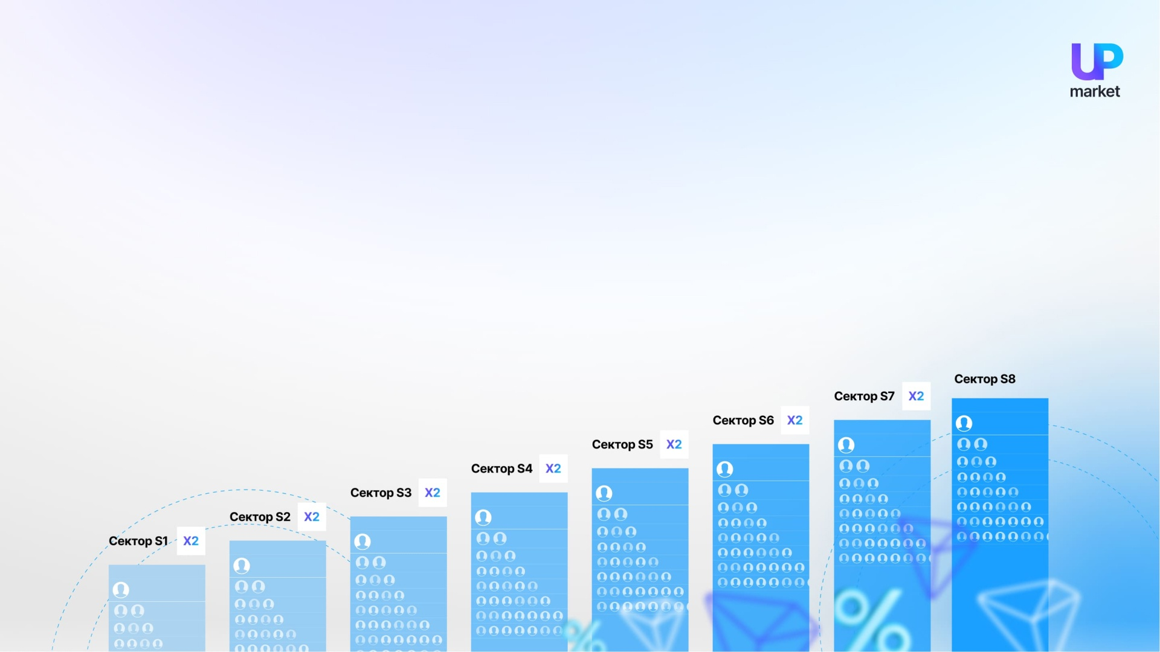


An increase in income
In order to increase income, additional sectors have been developed with eight levels of development.
Vouchers for each subsequent sector must be purchased two times more than those for the previous sector.
The following sectors can only be activated in order of priority and in advance.
Each time users activate new subsequent sectors, you receive additional revenue from your client base.
The additional sectors are activated only once.
There is no requirement for the activation of new additional sectors.

Slide 13
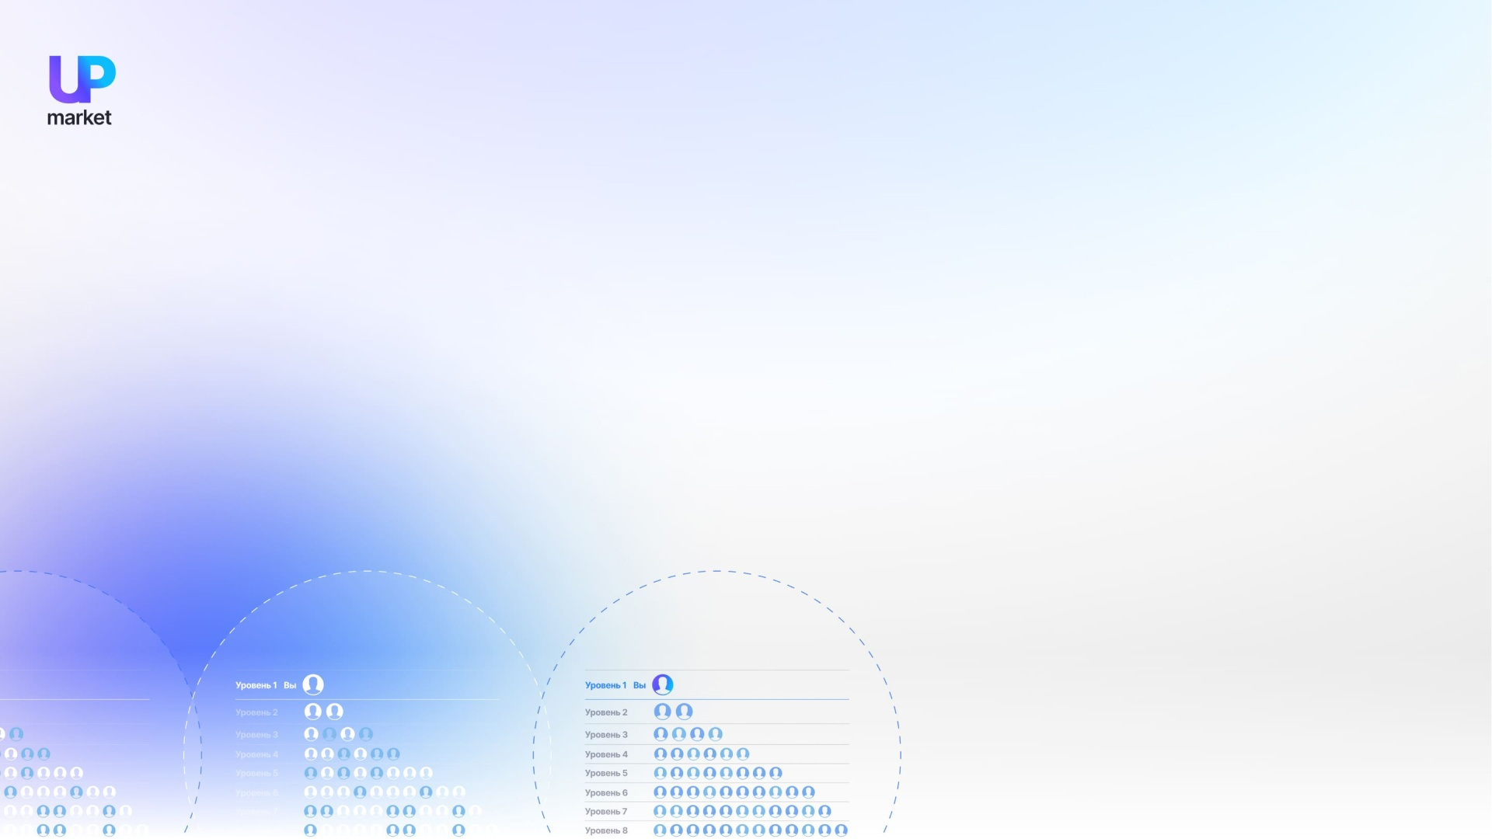
For each subsequent set, purchase the required number of vouchers. (6 USD/piece)
The activation
of subsequent sectors
One-time activation of additional sectors!
The gallery must have the required number of vouchers.
Any author on the site can sell vouchers to the general gallery to replenish each user's gallery.
Every time a new sector is activated, the user account is placed at the top of the new sector.

Slide 14



Here is some additional information
Participants in this sector are placed behind the superior partner who activated it.
The activation of sectors occurs only in the order of priority. For example, you cannot activate S3 before S2 and vice versa.
Vouchers are only able to purchase vouchers from active higher partners located in each additional sector when the user activates it.
Activating several sectors in advance is recommended for successful work in sectors, in order to not miss the opportunity of downstream partners buying your work.
A user's account placement order is preserved if additional sectors are not activated, but is preserved if further sectors are activated.
By activating sectors of higher levels that he has not yet activated, the program participant can overtake his parent. He will receive the reward for the sale of vouchers, not his partner. In the event the direct parent activates sectors that are the same price, he will be placed according to the referral binding.
«MARKET-UP» does not charge for blogging.

Slide 15

The target audience
*Anyone who is willing to receive income from their own business as well as from other participants' advertising vouchers.

Slide 16
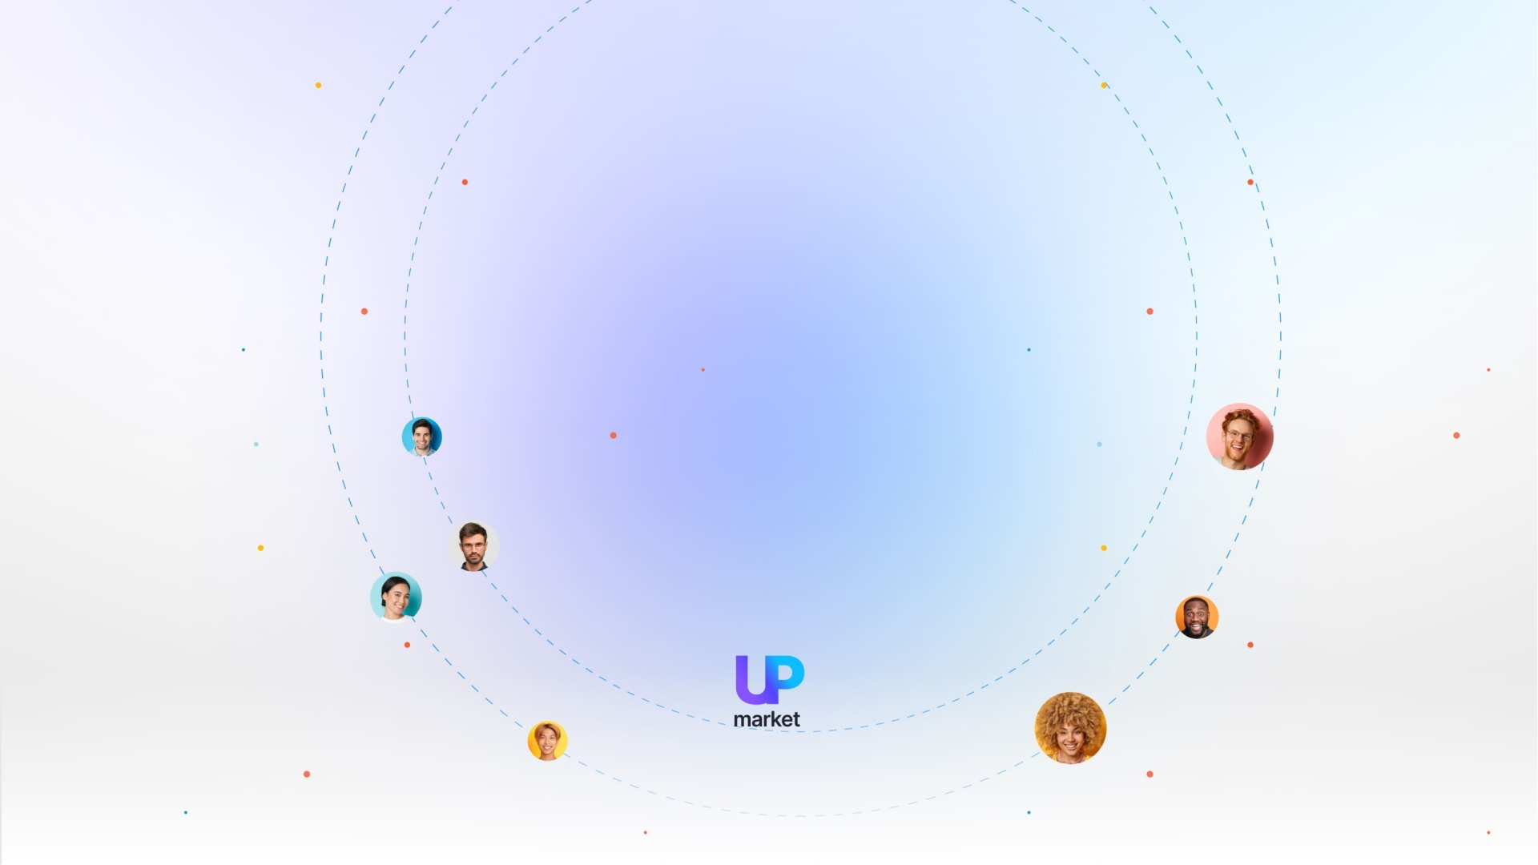
Our goal is to:
Attract new users to the platform in the next few years to get
more than 1 billion users.

